Slide 1


Choosing the Right Data Science Services in Azure
Scale, Automate, and Deploy with Ease

Slide 2
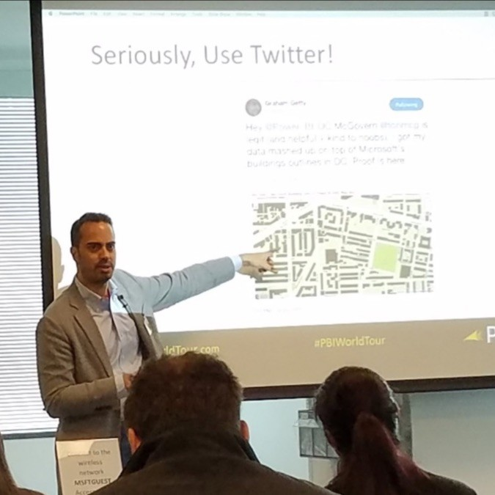



Tony McGovern
Hacker. Artist. Storyteller. Data lover.
Founder & Data Scientist
emdata.ai
@tonmcg
2

Slide 3
Session Objectives
Choose the right Azure machine learning product for the task at hand
Right-size the Azure machine learning services to fit your data science team
3
Notes:
The goal is to choose the Azure ML products that contain the minimal services that allow your team to build and productionize one AI or ML model quickly and cheaply

Slide 4
Agenda
Differentiate each of the Azure machine learning products
Identify key features of each product
Describe what use cases each product applies to
Understand which product best fits your data science team
4

Slide 5
Choosing the Right Data Science Services in Azure
Scale, Automate, and Deploy with Ease

Slide 6

Machine learning options on Azure
Azure Machine Learning service
Azure Machine Learning Studio
Azure Databricks
Azure Data Science Virtual Machine
SQL Server Machine Learning Services
6
Notes:
These are the machine learning options on Azure that allow data analysts, data engineers, data scientists, and AI engineers work collaboratively on AI and ML models. These products allow you to build models from the ground up.
I’m not discussing other Azure AI services like Cognitive Services, which doesn’t allow you to “build” models.
I’m also not going to discuss products like ML.NET because frankly I don’t know anything about it.
ML.NET:
https://medium.com/datadriveninvestor/6-reasons-microsoft-has-become-the-go-to-for-machine-learning-e642864ef5f5#425e

Slide 7





Machine learning options on Azure
Product | What it is | What you can do with it
Azure Machine Learning service | A managed cloud service for Machine Learning. | Train, deploy, and manage models in Azure using Python, Azure CLI, and Azure portal.
Azure Machine Learning Studio | A drag-and-drop visual interface for Machine Learning. | Build, experiment, and deploy models using preconfigured algorithms. Ideal for learning about Machine Learning.
Azure Databricks | Apache Spark–based analytics platform with an integrated notebook interface that seamlessly integrates with Azure Active Directory (Azure AD) and data services. | Build and deploy models and data workflows with big data.
Azure Data Science Virtual Machine | A virtual machine with preinstalled data science tools. | Develop machine learning solutions in a preconfigured data science environment.
SQL Server Machine Learning Services | Integrated with Microsoft SQL Server, this scalable analytics server supports the Python and R language. | Build and develop models in an on-premises SQL server that scales to match the SQL Server engine. Microsoft Machine Learning Server is also available as a cluster type in Azure HDInsight.
7
Notes:
This is a high-level review of the current Azure Machine Learning products that allow your team to build AL and ML models on Azure.
Note that Azure Machine Learning Studio is now a core feature in Azure Machine Learning service. And that Azure Machine Learning service is now in preview called Azure Machine Learning Studio.

Slide 8
An ideal data science team
Data / BI Analyst
Data Scientist
Data Engineer
Data Scientist
Data Engineer
Data Science Manager
AI Engineer
8
Notes:
This is the minimum team you should have to productionize AI and ML models that will give the enterprise a process to get predictions from a containerized model through an API.

Slide 9






An ideal data science team
Member | Responsibilities | Key Skills
Data Science Manager | Oversees and directs data science teams and projects and is the bridge between data and non-data people. | Management experience, programming skills (R / Python), strong communication.
Data / BI Analyst | Ensures collected data is relevant and exhaustive while also interpreting analytics results. | SQL, R / Python, Tableau / Power BI.
Data Scientist | Builds upon the analysts’ data work to develop predictive models and complex algorithms. | R, Python, Spark, Hadoop.
Data Engineer | Develops the infrastructure to house the data and maintains the structural components. | AWS, MongoDB, MySQL, Hadoop, C++.
ML Ops Engineer | Responsible for linking the ML application with a unified, production-grade platform and processes. | Distributed & Big data systems, MapReduce, Stream Processing, In-Memory Computing, Lambda & Kappa Architecture
9
Notes: ideal data science team content courtesy of Data Society
Notes:
For today, I describe an ideal data science team that will build and productionize one AI or ML model quickly and cheaply using the minimal Azure ML products within a typical machine learning modeling workflow.
As such, the assumption here is that the data science manager will do the work typically done by a data architect.

Slide 10
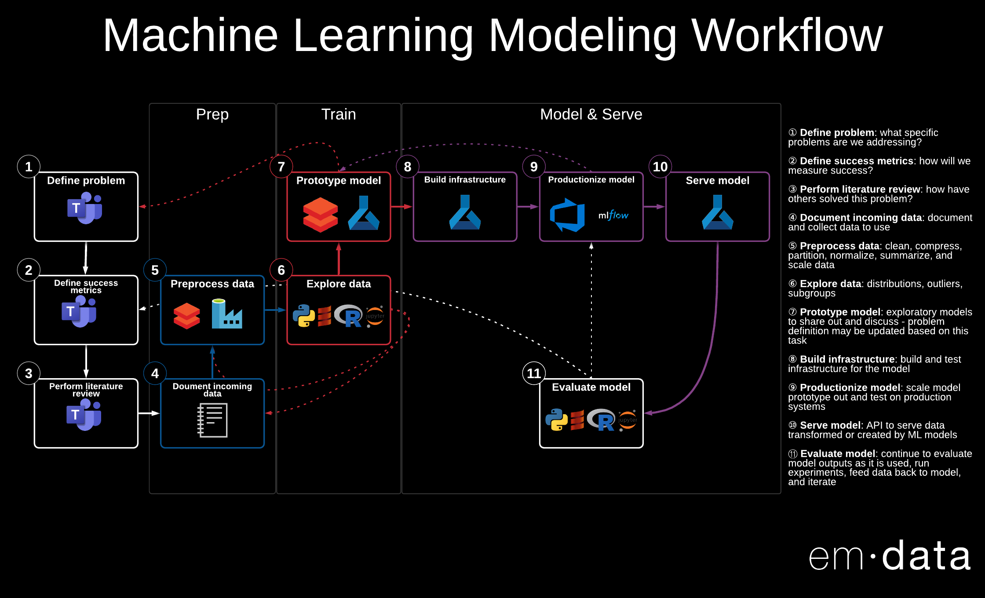
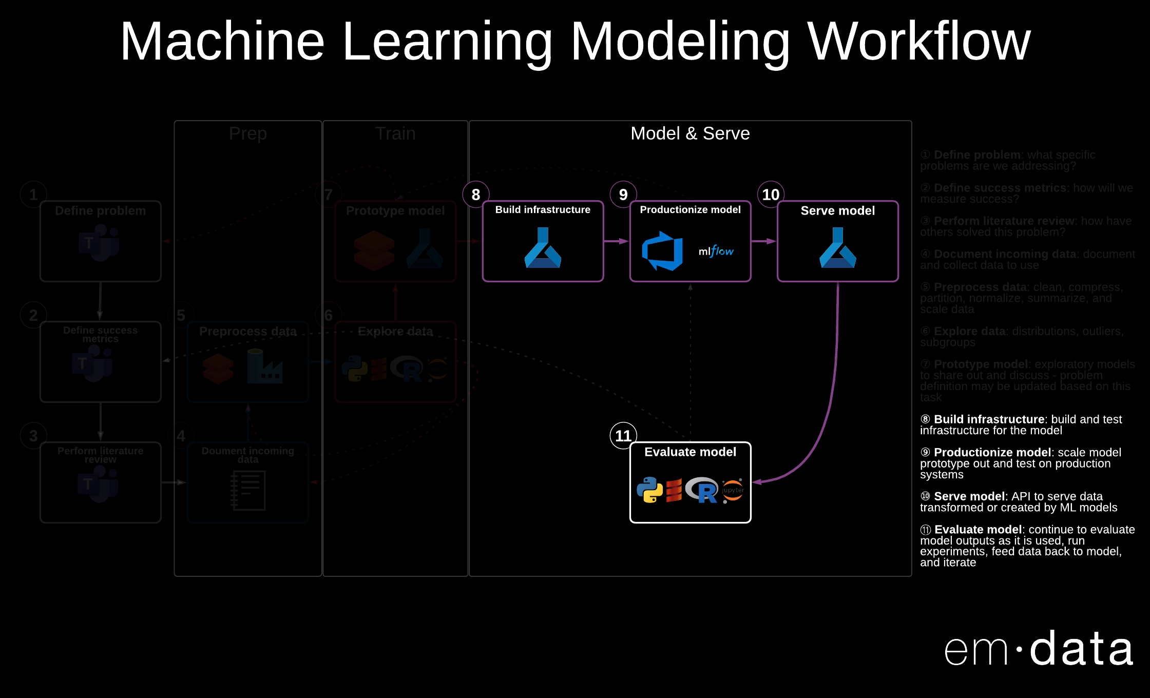
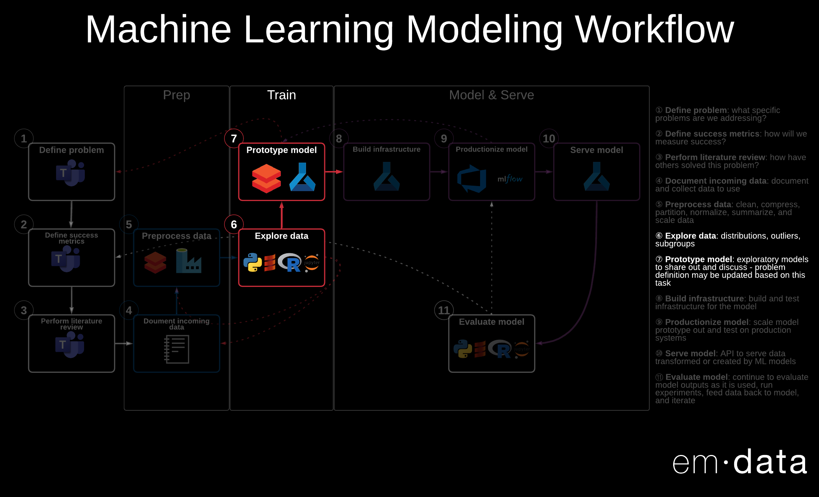
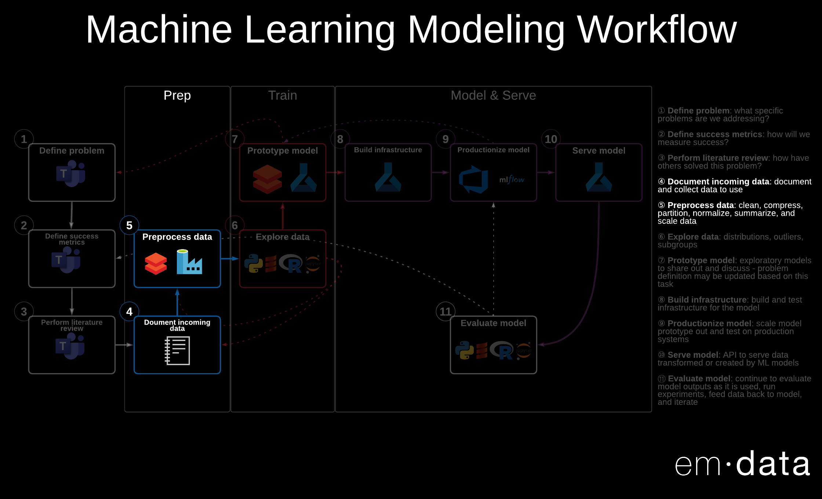
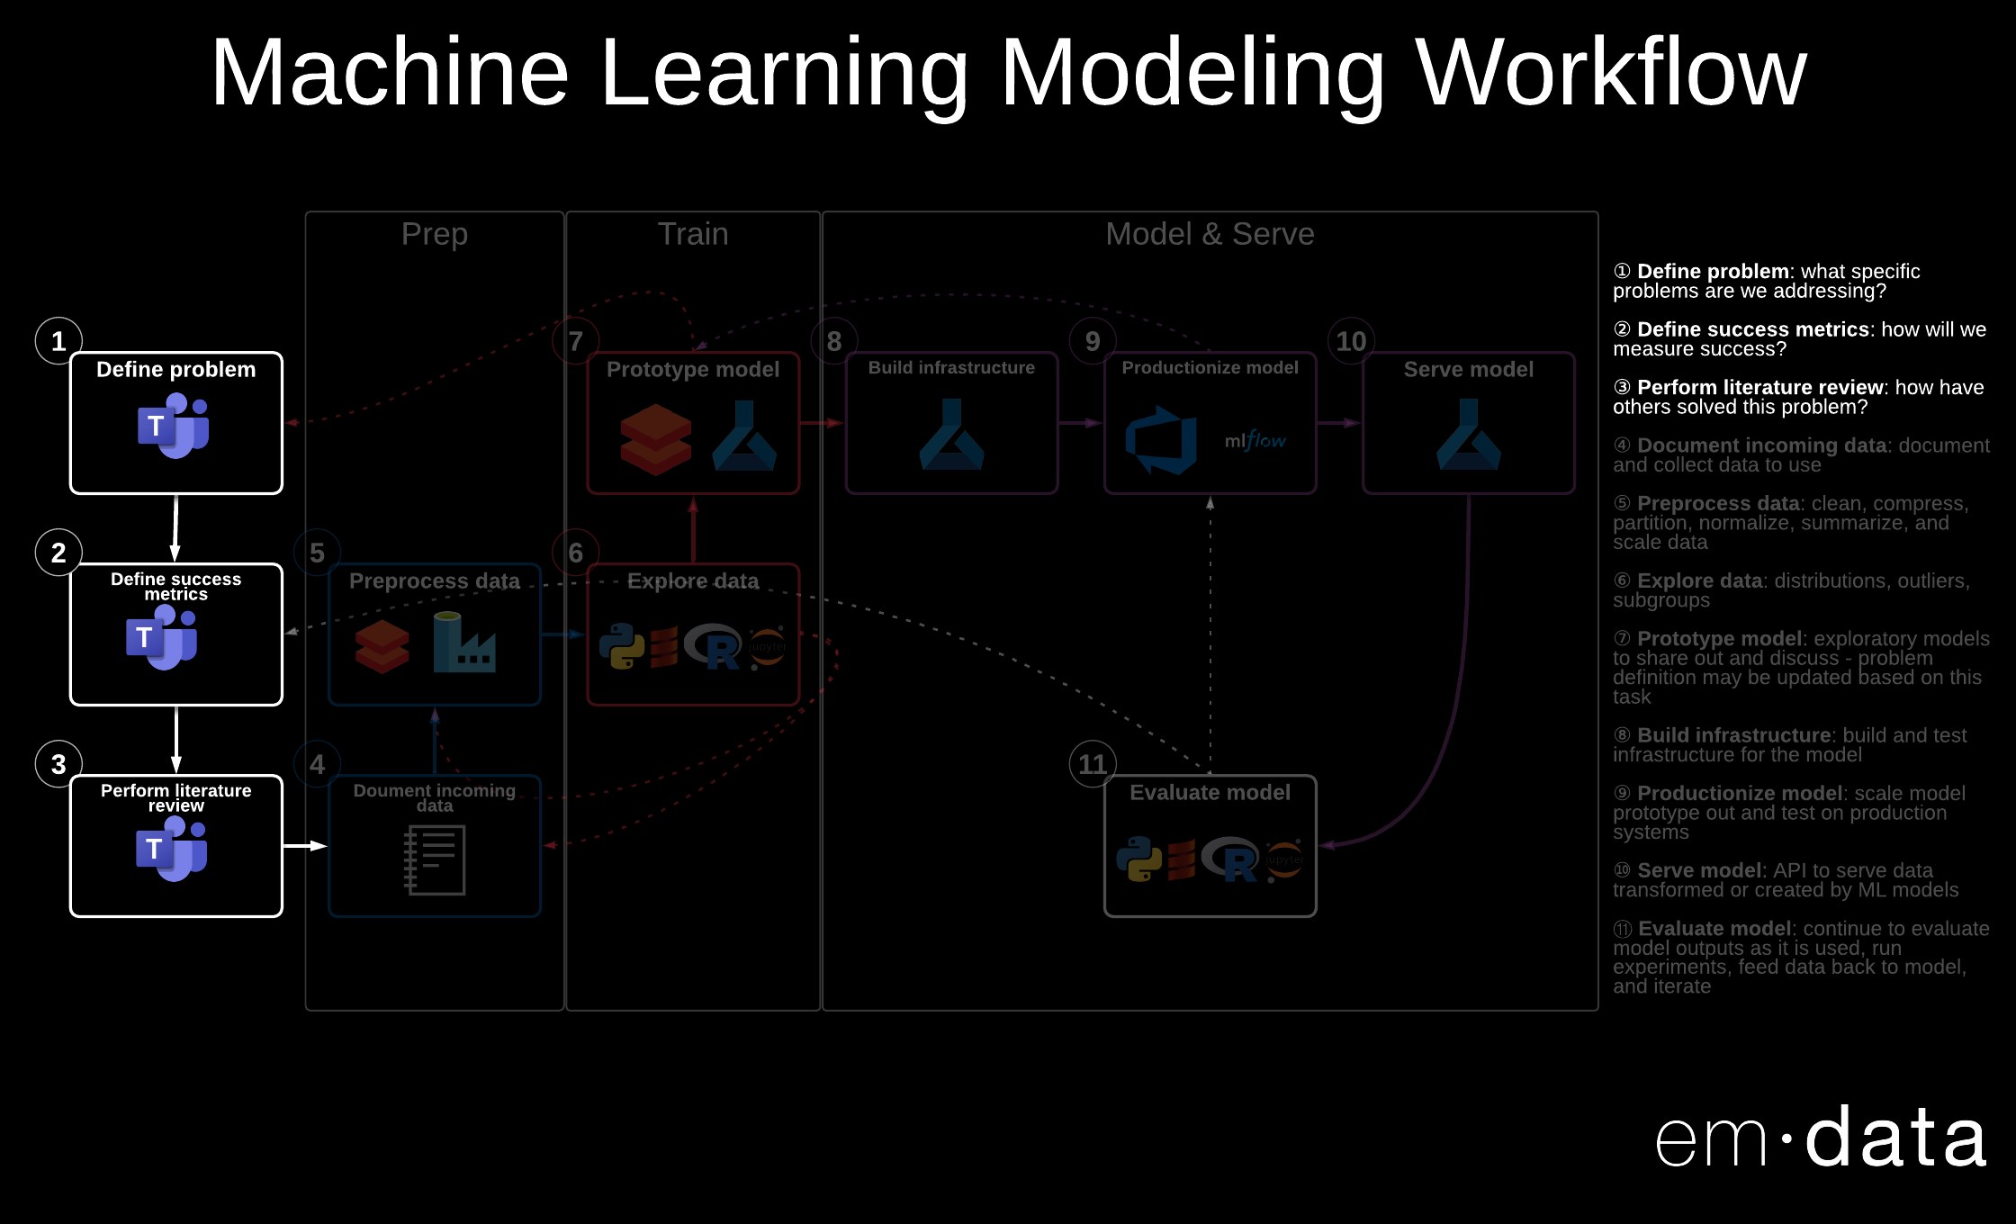
10
Notes:
This is a typical machine learning modeling workflow. It has four components:
Project Planning
Data Prep
Model Training
Model Operationalizing

Slide 11
Machine learning options on Azure
Product | What it is | What you can do with it
Azure Machine Learning service | A managed cloud service for Machine Learning. | Train, deploy, and manage models in Azure using Python, Azure CLI, and Azure portal.
Azure Machine Learning Studio | A drag-and-drop visual interface for Machine Learning. | Build, experiment, and deploy models using preconfigured algorithms. Ideal for learning about Machine Learning.
Azure Databricks | Apache Spark–based analytics platform with an integrated notebook interface that seamlessly integrates with Azure Active Directory (Azure AD) and data services. | Build and deploy models and data workflows with big data.
Azure Data Science Virtual Machine | A virtual machine with preinstalled data science tools. | Develop machine learning solutions in a preconfigured data science environment.
SQL Server Machine Learning Services | Integrated with Microsoft SQL Server, this scalable analytics server supports the Python and R language. | Build and develop models in an on-premises SQL server that scales to match the SQL Server engine. Microsoft Machine Learning Server is also available as a cluster type in Azure HDInsight.
11
Notes:
For today, I focus on the products that contain the minimal services that allow your team to build and productionize one AI or ML model quickly and cheaply.
Those products are Azure Machine Learning and Azure Databricks.

Slide 12
An ideal data science team – Proof of Concept Model
Data / BI Analyst
Data Scientist
Data Engineer
Data Scientist
Data Engineer
Data Science Manager
12
Notes:
Often we need to quickly build models to prove out an idea or problem that can be solved with data. This is the team you should have to build these proofs of concept.

Slide 13
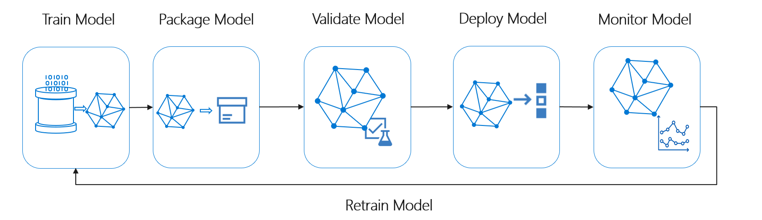
Productionizing ML Models
13
Notes:
What if you’re ready to operationalize a proof of concept? This is a flow provided by Microsoft that describes some of the steps involved.

Slide 14
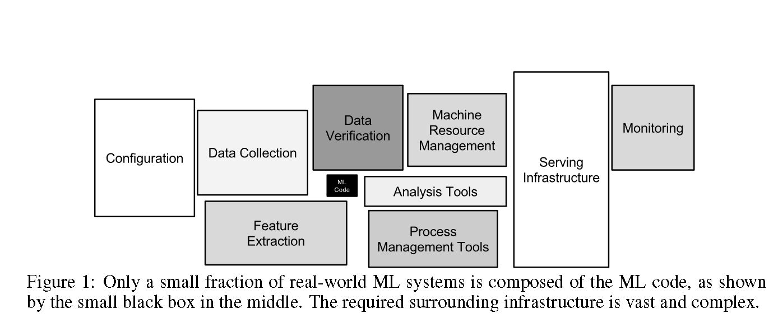
Productionizing ML Models – Key Challenges
14
Source: Hidden Technical Debt in Machine Learning Systems
Notes:
What if you’re ready to operationalize a proof of concept? The small black box in the middle is your proof of concept. The rest is what you need to operationalize your ML model.

Slide 15
Productionizing ML Models – Key Challenges
Model reproducibility & versioning
Track, snapshot & manage assets used to create the model
Enable collaboration and sharing of ML pipelines
Model auditability & explainability
Maintain asset integrity & persist access control logs
Certify model behavior meets regulatory & adversarial standards
Model packaging & validation
Support model portability across a variety of platforms
Certify model performance meets functional and latency requirements
Model deployment & monitoring
Release models with confidence
Monitor & know when to retrain by analyzing signals such as concept or data drift
15

Slide 16
An ideal data science team – Production Model
Data / BI Analyst
Data Scientist
Data Engineer
Data Scientist
Data Engineer
Data Science Manager
AI Engineer
16
Notes:
This is the team you should have to operationalize proofs of concept so that you have an infrastructure that enables your team to have model reproducibility, versioning, auditability, explainability, portability, monitoring, and track challenges outside the model like concept or data drift

Slide 17
17
Notes:
This is a typical machine learning modeling workflow. Let’s take a look at how :
Project Planning
Data Prep
Model Training
Model Operationalizing

Slide 18
Azure Machine Learning service
Azure Machine Learning Studio
Azure Databricks
Azure Data Science Virtual Machine
SQL Server Machine Learning Services
Supports data science pipeline integration
Allows for scaling up and automation
Allows for easily containerization and automation
18

Slide 19
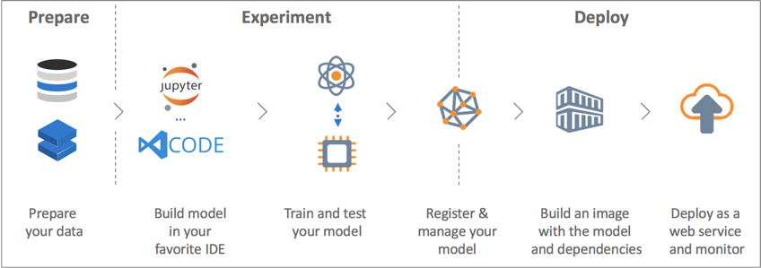
Azure Machine Learning service
Azure Machine Learning Studio
Azure Databricks
Azure Data Science Virtual Machine
SQL Server Machine Learning Services
19

Slide 20
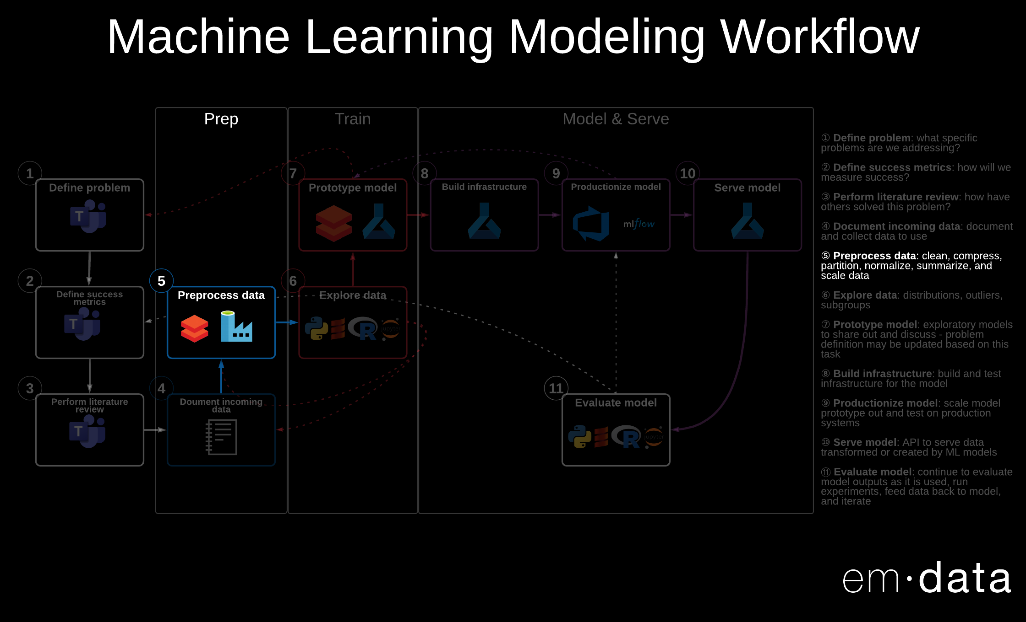
20
Notes:
This is a Data Prep portion focusing on Data Preprocessing:

Slide 21
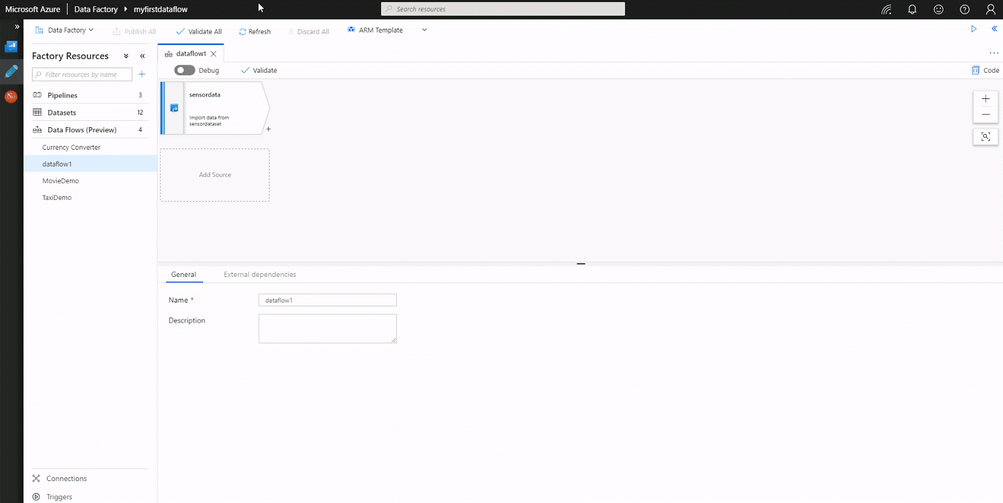
Azure Machine Learning service
Azure Machine Learning Studio
Azure Databricks
Azure Data Science Virtual Machine
SQL Server Machine Learning Services
21
Notes:
This is Azure Data Factory, which allow you to perform “light-touch” data preparation, and pipeline orchestration through an intuitive UI on a Spark-based cluster

Slide 22
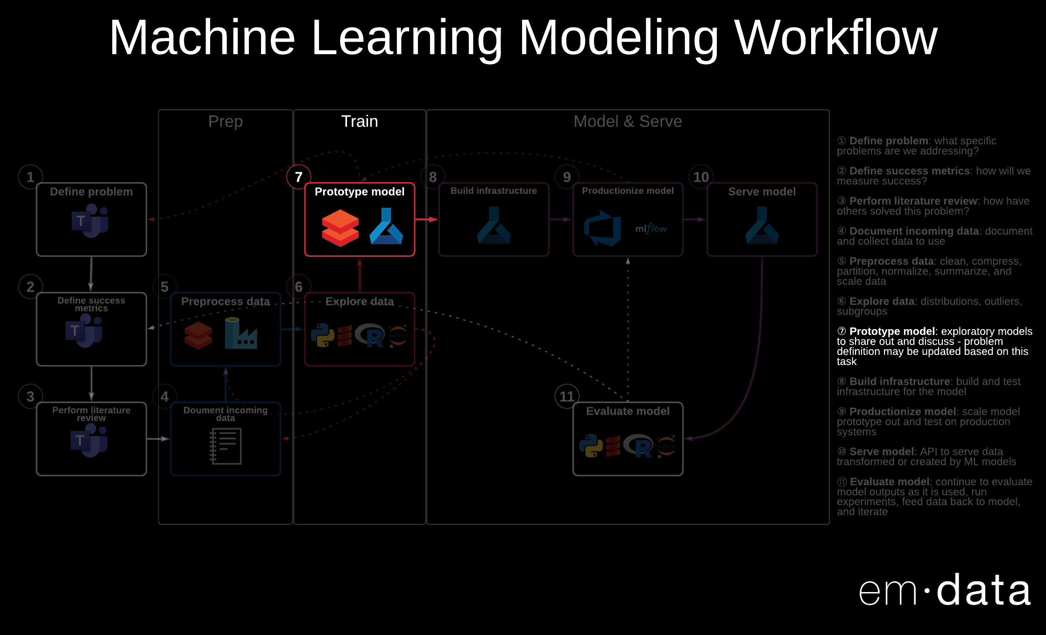
22
Notes:
This is a Model Train portion focusing on prototyping models

Slide 23
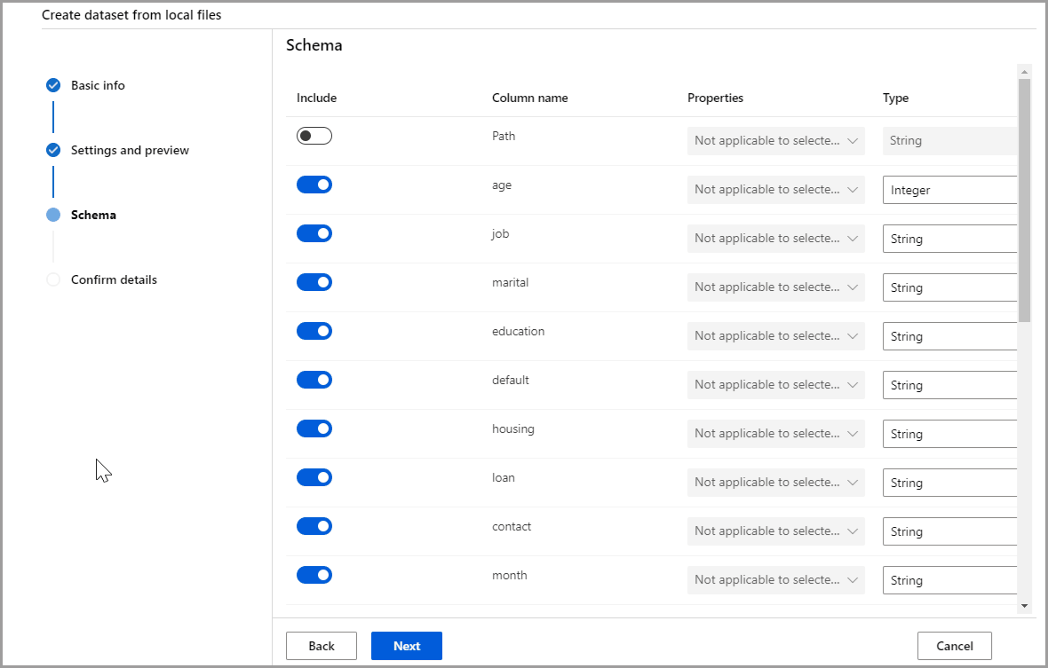
Azure Machine Learning service
Azure Machine Learning Studio
Azure Databricks
Azure Data Science Virtual Machine
SQL Server Machine Learning Services
23

Slide 24
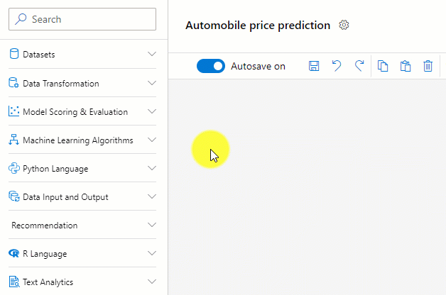
Azure Machine Learning service
Azure Machine Learning Studio
Azure Databricks
Azure Data Science Virtual Machine
SQL Server Machine Learning Services
24

Slide 25
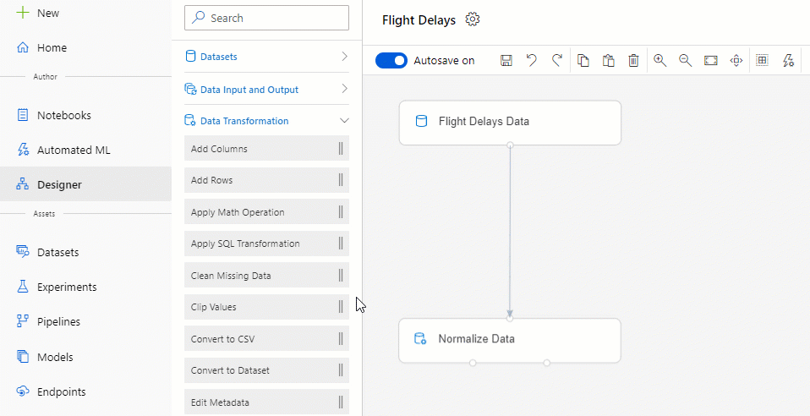
Azure Machine Learning service
Azure Machine Learning Studio
Azure Databricks
Azure Data Science Virtual Machine
SQL Server Machine Learning Services
25

Slide 26
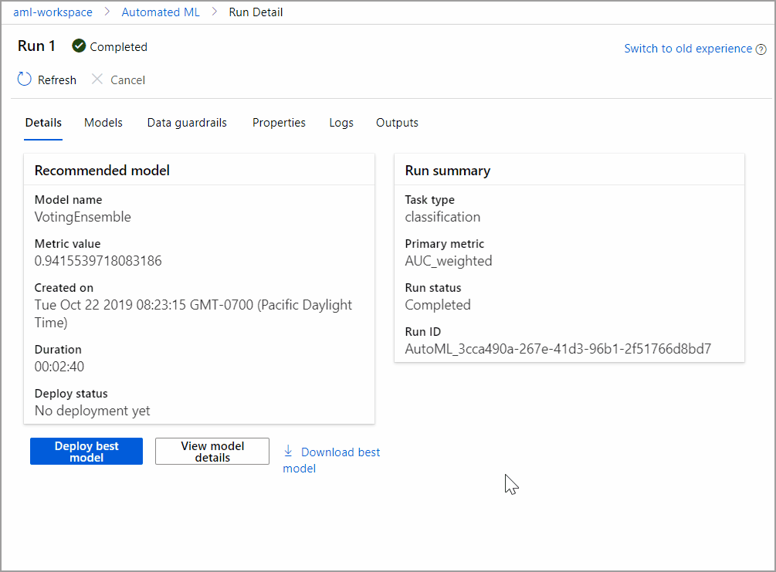
Azure Machine Learning service
Azure Machine Learning Studio
Azure Databricks
Azure Data Science Virtual Machine
SQL Server Machine Learning Services
26

Slide 27
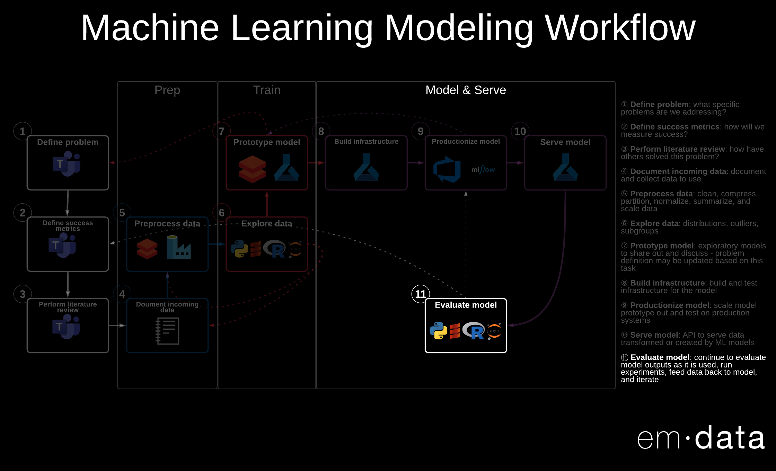
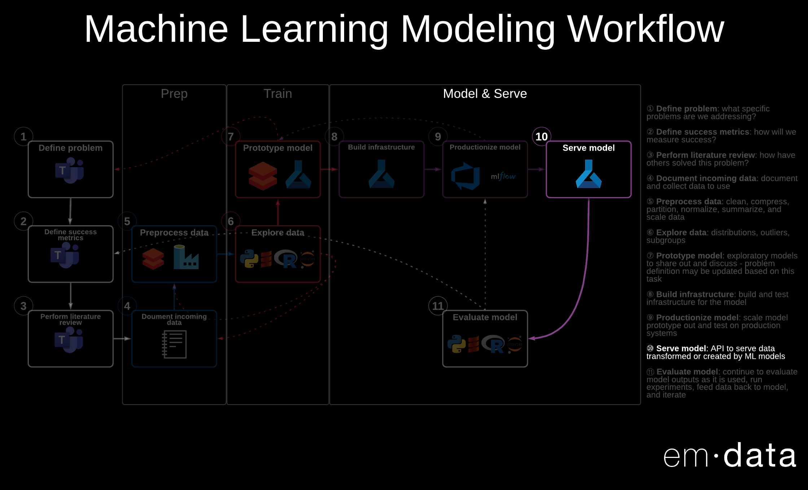
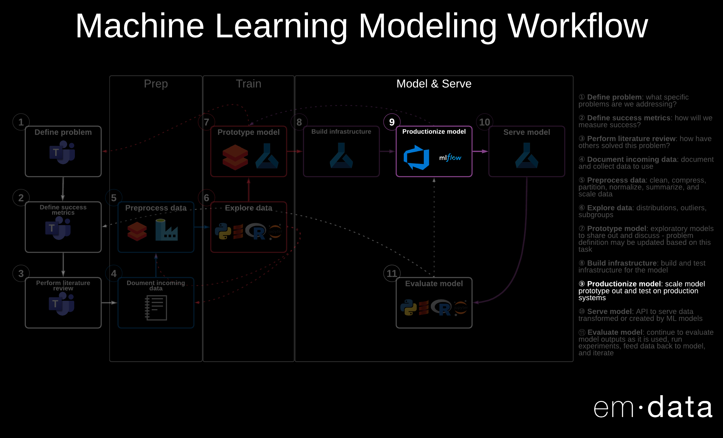
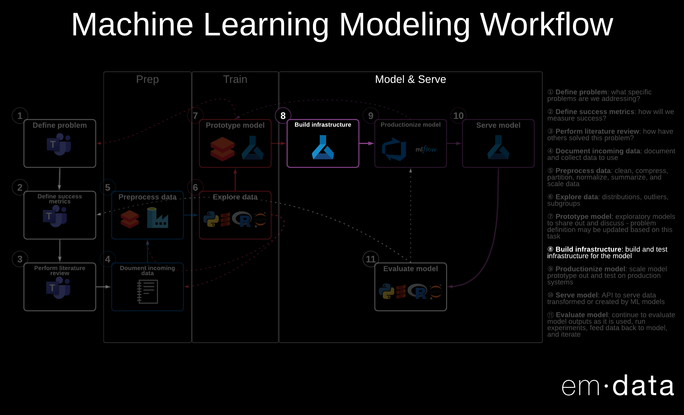
27
Notes:
This is a Model Operationalizing portion focusing on:
Building infrastructure
Productionizing model
Serving model
Evaluating model

Slide 28
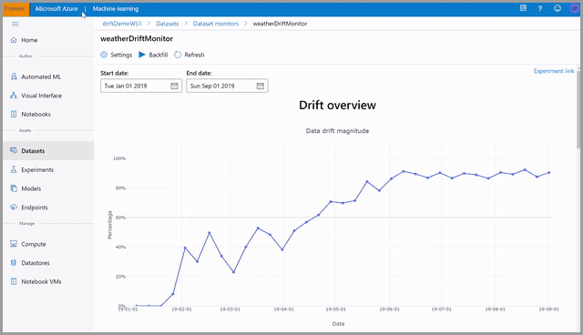
Azure Machine Learning service
Azure Machine Learning Studio
Azure Databricks
Azure Data Science Virtual Machine
SQL Server Machine Learning Services
28

Slide 29
Azure Machine Learning service
Azure Machine Learning Studio
Azure Databricks
Azure Data Science Virtual Machine
SQL Server Machine Learning Services
Secure, all-in-one data science team collaboration platform
Includes a notebook interface, job scheduling, Azure Active Directory integration, granular security control, and seamless Azure integration
GUI-based cloud portal that allows easy interaction with Spark big data platform
29
Notes:
Azure Databricks is an Apache Spark-based analytics platform widely used in machine learning for exploration and modeling. It enables the data scientist and data engineer to write code in data science notebooks using Java, Python, R, Scala, or SQL while also leveraging the power of distributed processing with automated cluster management.
Databricks environments and clusters can be created and managed automatically with Azure Resource Manager templates and PowerShell scripts. Azure Databricks also supports various types of visualizations out of the box using the display function. It is useful to remember that the work done here by a data scientist will, in general, center on supporting their experiments. It is too early to be thinking about scalability or resilience. But, if the experiment results in a compelling discovery for business, it will fall to the data engineer to deploy the project. In that case, this work does not necessarily need to be rebuilt. Azure Data Factory has connectors which enables a data engineer to trigger the running of Azure Databricks notebooks in a pipeline. They can assign compute power to scale the execution of notebooks on a cluster. With this capability the engineer can run notebooks consistently for the enterprise, orchestrated with other processes.

Slide 30
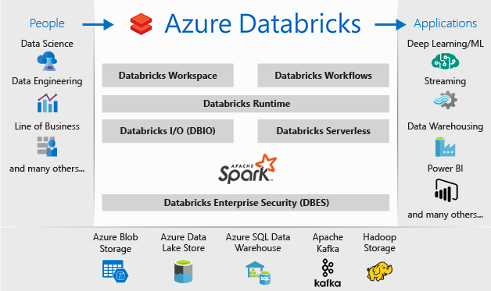
Azure Machine Learning service
Azure Machine Learning Studio
Azure Databricks
Azure Data Science Virtual Machine
SQL Server Machine Learning Services
30

Slide 31
31
Notes:
This is a Data Prep portion focusing on Data Preprocessing

Slide 32
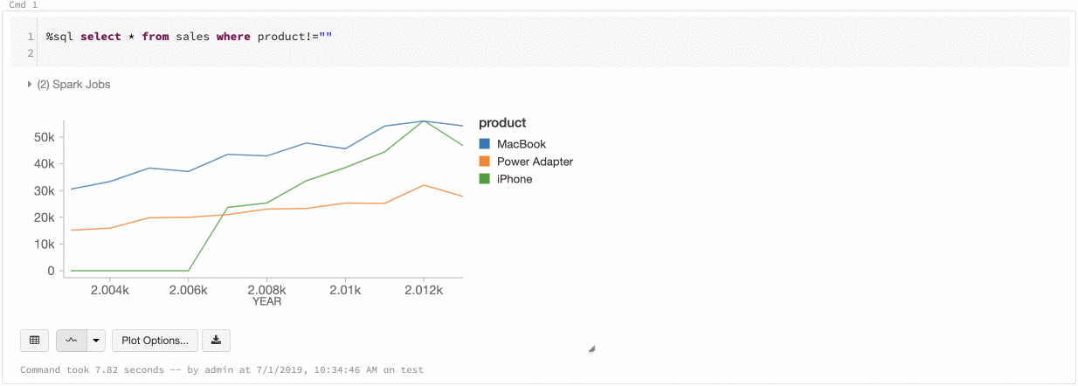
Azure Machine Learning service
Azure Machine Learning Studio
Azure Databricks
Azure Data Science Virtual Machine
SQL Server Machine Learning Services
32

Slide 33
33
Notes:
This is a Model Train portion focusing on prototyping models

Slide 34
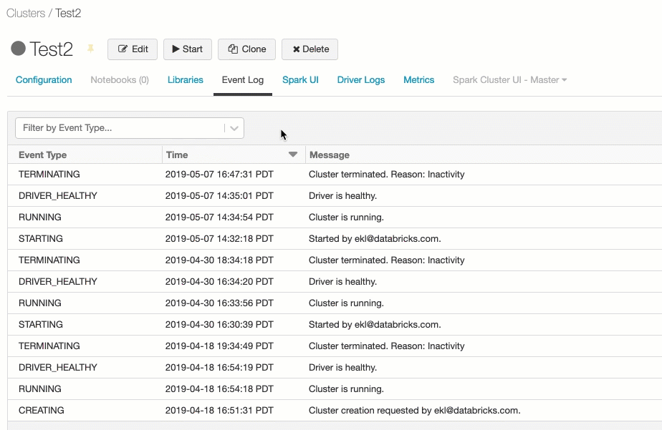
Azure Machine Learning service
Azure Machine Learning Studio
Azure Databricks
Azure Data Science Virtual Machine
SQL Server Machine Learning Services
34

Slide 35
35
Notes:
This is a Model Operationalizing portion focusing on:
Building infrastructure
Productionizing model
Serving model
Evaluating model

Slide 36
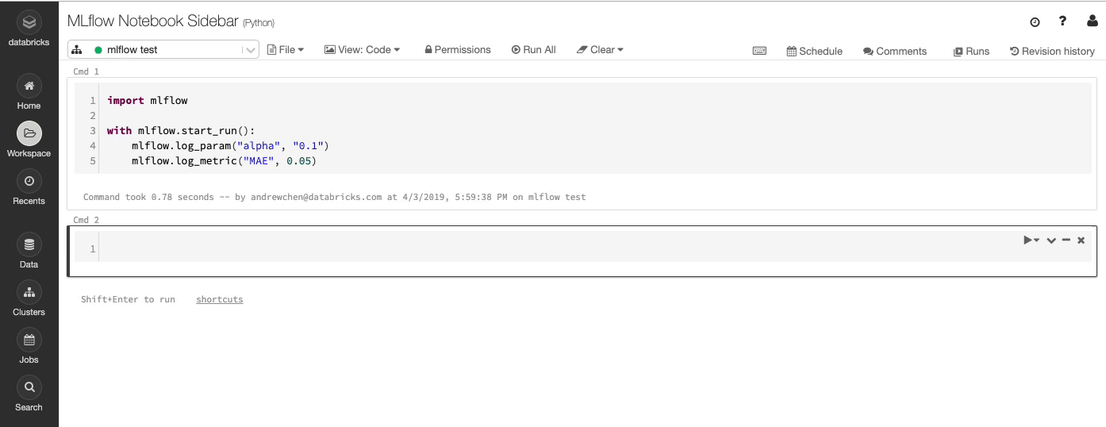
Azure Machine Learning service
Azure Machine Learning Studio
Azure Databricks
Azure Data Science Virtual Machine
SQL Server Machine Learning Services
36

Slide 37
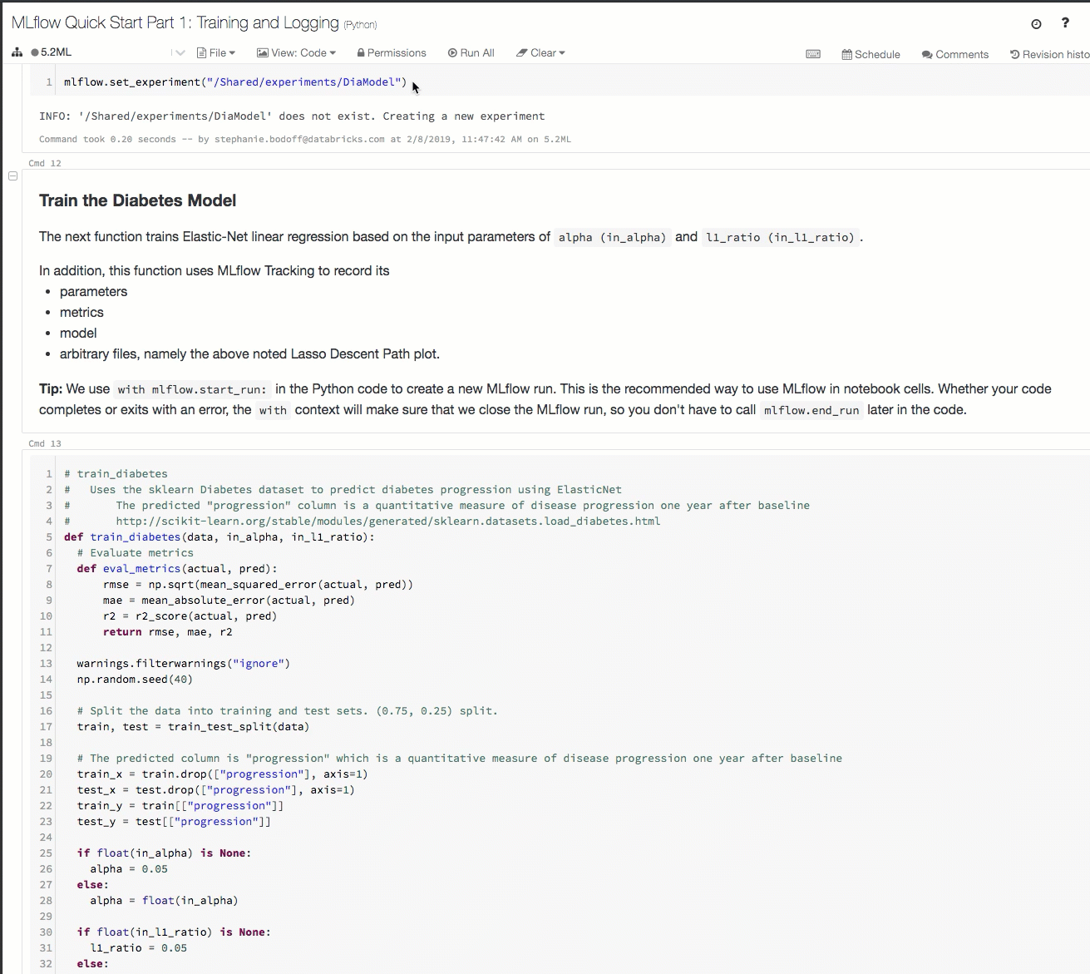
Azure Machine Learning service
Azure Machine Learning Studio
Azure Databricks
Azure Data Science Virtual Machine
SQL Server Machine Learning Services
37

Slide 38
Machine learning options on Azure
Product | What it is | What you can do with it
Azure Machine Learning service | A managed cloud service for Machine Learning. | Train, deploy, and manage models in Azure using Python, Azure CLI, and Azure portal.
Azure Machine Learning Studio | A drag-and-drop visual interface for Machine Learning. | Build, experiment, and deploy models using preconfigured algorithms. Ideal for learning about Machine Learning.
Azure Databricks | Apache Spark–based analytics platform with an integrated notebook interface that seamlessly integrates with Azure Active Directory (Azure AD) and data services. | Build and deploy models and data workflows with big data.
Azure Data Science Virtual Machine | A virtual machine with preinstalled data science tools. | Develop machine learning solutions in a preconfigured data science environment.
SQL Server Machine Learning Services | Integrated with Microsoft SQL Server, this scalable analytics server supports the Python and R language. | Build and develop models in an on-premises SQL server that scales to match the SQL Server engine. Microsoft Machine Learning Server is also available as a cluster type in Azure HDInsight.
38
Notes:
For today, I focus on the products that contain the minimal services that allow your team to build and productionize one AI or ML model quickly and cheaply.
Those products are Azure Machine Learning and Azure Databricks.

Slide 39
An ideal data science team – Proof of Concept Model
Data / BI Analyst
Data Scientist
Data Engineer
Data Scientist
Data Engineer
Data Science Manager
39
Notes:
Often we need to quickly build models to prove out an idea or problem that can be solved with data. This is the team you should have to build these proofs of concept.

Slide 40
Productionizing ML Models – Key Challenges
40
Source: Hidden Technical Debt in Machine Learning Systems
Notes:
What if you’re ready to operationalize a proof of concept? The small black box in the middle is your proof of concept. The rest is what you need to operationalize your ML model.

Slide 41
An ideal data science team – Production Model
Data / BI Analyst
Data Scientist
Data Engineer
Data Scientist
Data Engineer
Data Science Manager
AI Engineer
41
Notes:
This is the team you should have to operationalize proofs of concept so that you have an infrastructure that enables your team to have model reproducibility, versioning, auditability, explainability, portability, monitoring, and track challenges outside the model like concept or data drift

Slide 42
42
Notes:
This is a typical machine learning modeling workflow. It has four components:
Project Planning
Data Prep
Model Training
Model Operationalizing

Slide 43
Questions?

Slide 44
Resources
Azure Machine Learning Service
Microsoft Learn: Azure Machine Learning Service https://docs.microsoft.com/en-us/learn/modules/choose-data-science-option-in-azure/8-azure-ml-service
Microsoft Docs: What is Azure Machine Learning? https://docs.microsoft.com/en-us/azure/machine-learning/service/overview-what-is-azure-ml
Azure Machine Learning Studio(classic)
Microsoft Learn: Azure Machine Learning Studio(classic) https://docs.microsoft.com/en-us/learn/modules/choose-data-science-option-in-azure/4-azure-ml-studio
Microsoft Docs: How Azure Machine Learning differs from ML Studio (classic)? https://docs.microsoft.com/en-us/azure/machine-learning/compare-azure-ml-to-studio-classic
Azure Databricks
Microsoft Learn: Azure Databricks https://docs.microsoft.com/en-us/learn/modules/choose-data-science-option-in-azure/7-azure-databricks
Microsoft Docs: What is Azure Databricks? https://docs.microsoft.com/en-us/azure/azure-databricks/what-is-azure-databricks
Data Science Virtual Machine
Microsoft Learn: Data Science Virtual Machine https://docs.microsoft.com/en-us/learn/modules/choose-data-science-option-in-azure/3-dsvm
Microsoft Docs: What is the Azure Data Science Virtual Machine for Linux and Windows? https://docs.microsoft.com/en-us/learn/modules/choose-data-science-option-in-azure/3-dsvm
SQL Server Machine Learning Services
Microsoft Learn: SQL Server Machine Learning Services https://docs.microsoft.com/en-us/learn/modules/choose-data-science-option-in-azure/5-sql-ml-server
Microsoft Docs: What is SQL Server Machine Learning Services (Python and R)? https://docs.microsoft.com/en-us/sql/advanced-analytics/what-is-sql-server-machine-learning?view=sql-server-ver15
44

Slide 45


